Slide 1
Quantum LDPC Decoding
Aidan Westphal James Bialas Yi Hung Lim

Slide 2
Background Theory

Slide 3
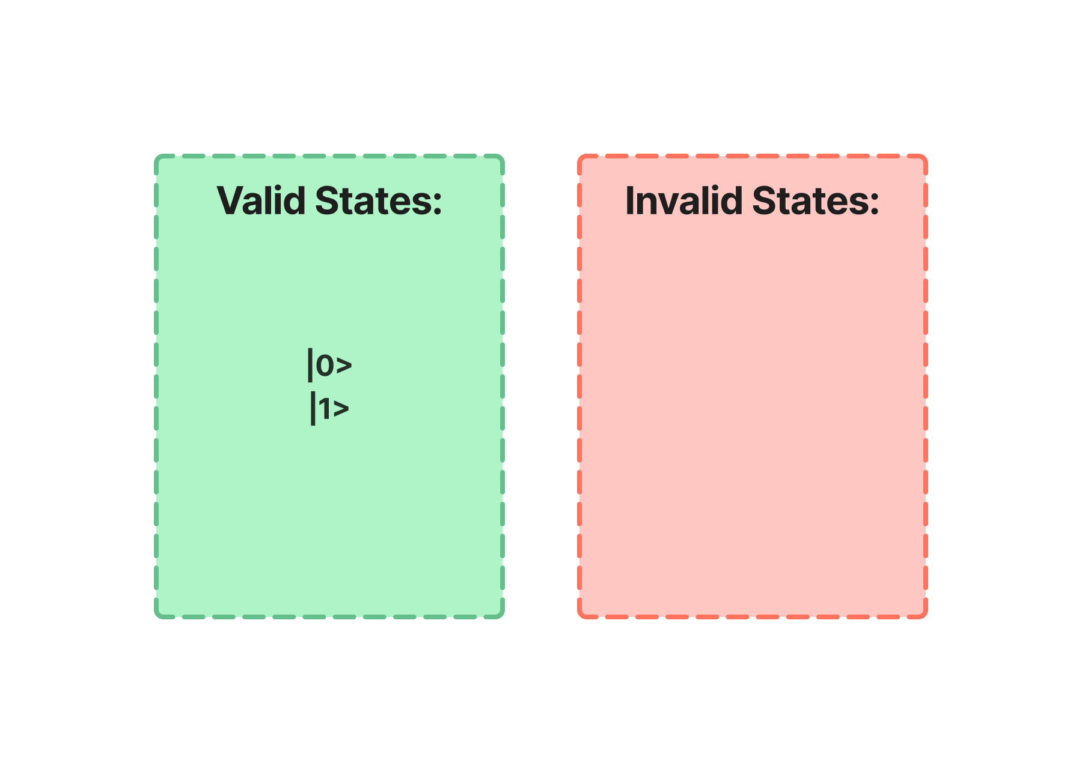
Redundancy
Consider a simple qubit |0> or |1>
If bit flip occurs, we still have a valid state
By adding redundancy, only SOME states represent valid information
If we have an invalid state, we know we received error and can fix it!

Slide 4
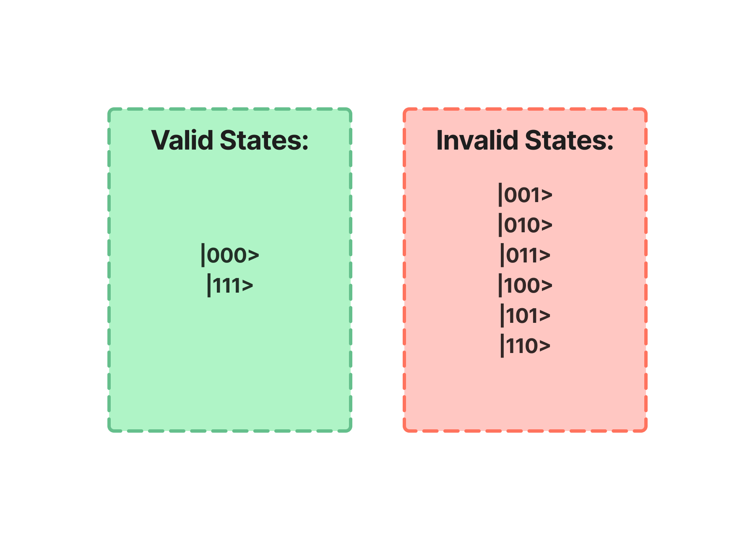
Linear Code
What if we encode |0> as |000> and |1> as |111>?
Now we have cases where we KNOW there is error!

Slide 5
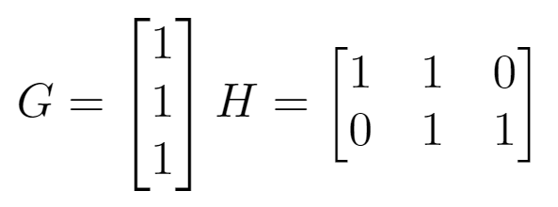
What is a Code?
(CLASSICAL)
[n,k] encodes k bits into n bits.
Binary Linear Code example is [3,1]
The valid states are codewords and represent valid information.
A state is encoded by a generator matrix (G).
G[0] = [000] and G[1] = [111]
We use a parity check matrix (H) to check if a state is a codeword or not.
Operates on an encoded vector (like [101])
The codewords are the null vectors of H!

Slide 6
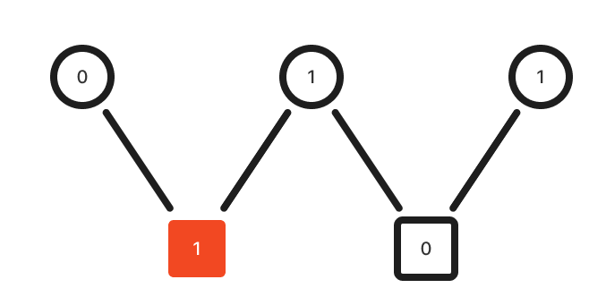

Syndromes
A syndrome is the set of parities returned from the H matrix.
Since codewords are in the nullspace of H, any nonzero vector implies error.
A Tanning Graph can visualize a syndrome.

Slide 7
Correcting Error
Any codeword is of the form y = Gx and Hy = 0.
An error e alters a state y’ = y + e.
The parity of this state is H(y + e) = Hy + He = He.
Our syndrome s = He fully describes the error.
If we can find e, we can simply invert these values from our faulty state y’.
This is the job of a decoder.

Slide 8
Moving Towards Quantum: CSS Codes

Slide 9
Dual Codes
Consider a [n, k] code C with generator G and PCM H.
A dual code is defined as the orthogonal set of codewords.
The dual [n, n - k] code C⟂ has generator H^{T} and PCM G^{T}.
Every code has a dual.

Slide 10
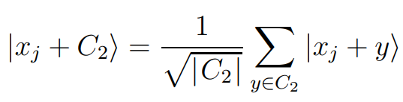
Calderbank-Shor-Steane Codes
CSS Codes combine two classical codes, notated CSS(C₁,C₂).
C₂ is [n, k₂] and C₁ is [n, k₁] for k₂ < k₁.
C₂ must be a subset of C₁.
For every codeword x within C₁, we have a codeword in the CSS code of x plus every codeword in C₂.
We then normalize this term.
Don’t worry much about this part.

Slide 11
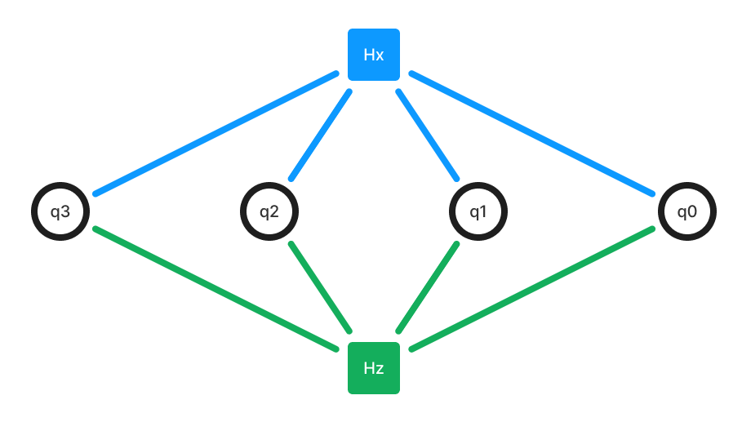
CSS Codes Abstracted
Example: [4,2] code with
H_{x} = H_{z} = [1 1 1 1]
It can be shown that a CSS code of CSS(C₁,C₂) can break apart bit and phase errors in quantum codes. We can solve for bit flip errors using C₁ and for phase flip errors using C₂⟂.
In other words, we can split up bit flip and phase flip error into two separate codes, with parity check matrices H_{x} and H_{z}.

Slide 12
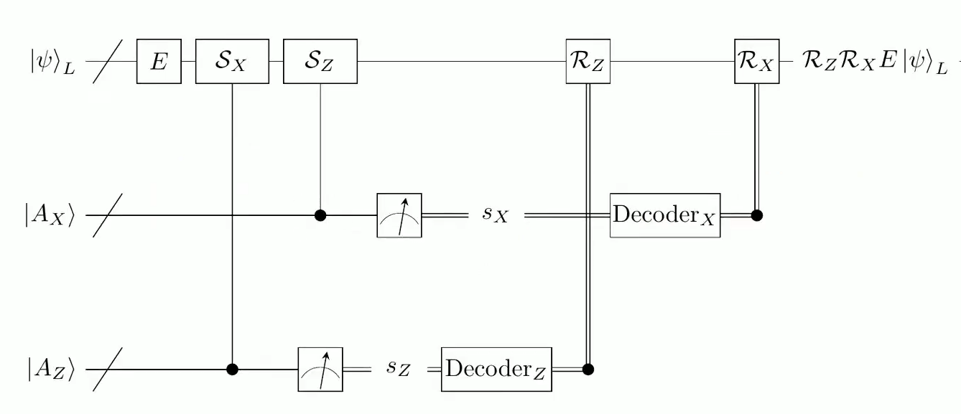
Splitting up the problem!
Using CSS codes we can divide into Z and X error correction.
Each half has its own syndrome measurement and decoding.
Each decoding returns some solution R.

Slide 13
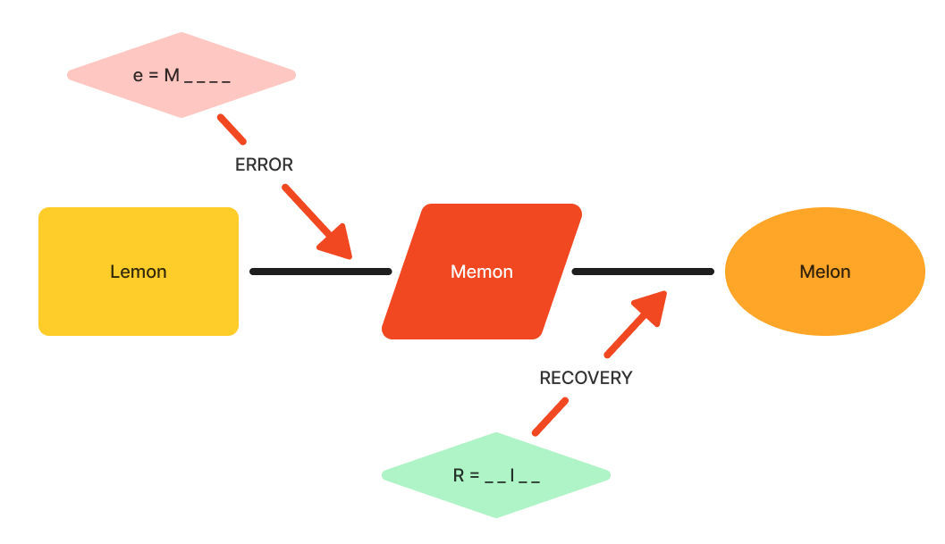
Rx, Rz, and E
In this example, residual error maps Lemon to Melon, and thus is a “Logical Operator.”
Recovery operators (Rx and Rz) are Pauli operators (such as I⮾X⮾X)
E is the error from the system
We define Residual Error as RxRzE.
If residual error has no impact on the codeword, we succeeded. If it changes the codeword, we failed.
If residual error has no impact, it’s a stabilizer. If it changes from one codeword to another, it’s a logical operator.

Slide 14
Belief Propagation Decoding

Slide 15
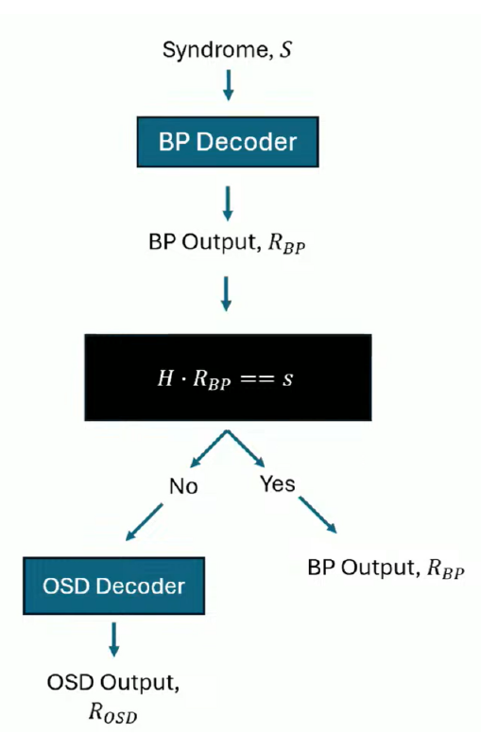
Solving Syndromes
A BP decoder is used to solve for R_{BP}
If H*R_{BP}==s, we have found our correction
H is the parity error matrix

Slide 16
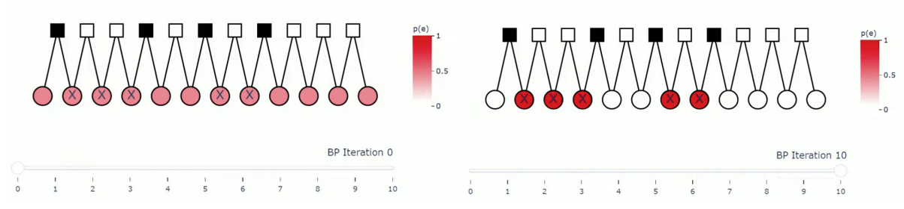
How does it work?
Assigns equal probability of error to each bit
Runs n-1 times, n being the number of parity bits
The error probability will be accumulated in the flipped bits
This will give us the matrix R_{BP}

Slide 17
Markov Decision Process
 |  |  | Goal (reward)
 |  |  | Punishment
 | Robot
Select Random Position for our starting box
Explore possible paths to reach the goal
Uses positive and negative reinforcement
Find paths from each cell to get to the goal

Slide 18
Markov Decision Process
 |  |  | Goal (reward)
 |  |  | Punishment
 | Robot
Select Random Position for our starting box
Explore possible paths to reach the goal
Uses positive and negative reinforcement
Find paths from each cell to get to the goal

Slide 19
Markov Decision Process
 |  |  | Goal (reward)
 |  |  | Punishment
Select Random Position for our starting box
Explore possible paths to reach the goal
Uses positive and negative reinforcement
Find paths from each cell to get to the goal

Slide 20
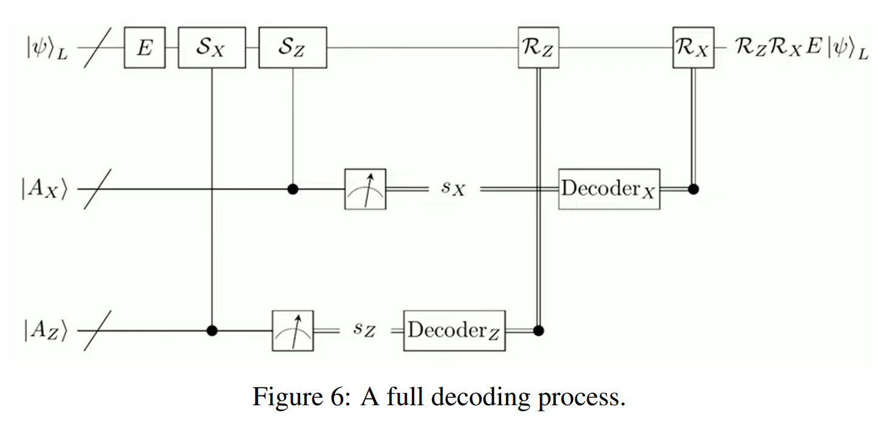
Finding a solution
Using R_{BP}, we can calculate the syndrome using H*R_{BP}.
If this equals s, we have found our correction
If not, we must use Ordered Statistic Decoding

Slide 21
Ordered Statistic Decoding

Slide 22
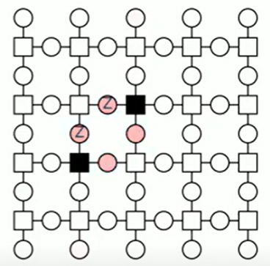
When does BP fail?
Belief Propagation fails when it can’t find a solution R to H R = s
Can occur from trapping sets where there is a small number of check node neighbors for bit nodes leading to errors that are hard to correct
If there is no solution, we then turn to OSD Decoder which always returns a solution.
Notes:
So in previous slides, we were introduced the belief propagation algorithm, but it can fail when there is trapping sets. Trapping sets are basically specific topologies in the tanner graph that lead to errors that are hard to correct. If you look at the diagram on the right, the belief propagation assigns high probability of error for all four of the red nodes as indicated by the black squares, the algorithm will then correct all four bits which will not correct the errors because you have to either only correct the top and left bit or the right and bottom bit, but not all four.

Slide 23
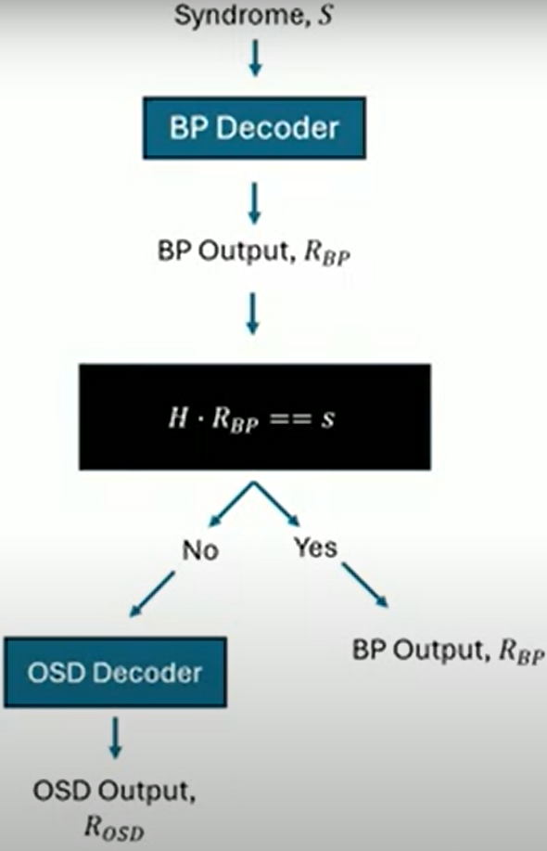
After BP fails
We turn to OSD Decoder if
H R = s is not satisfied
Notes:
So if Belief Propagation does not have a solution to the equation H R = s, we then turn to ordered statistics decoding which will always return a solution.

Slide 24
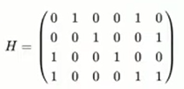

Ordered Statistic Decoding Intuition
Given a party check matrix
We cannot solve for the inverse of H
But we can invert a full-rank submatrix
which gives a solution for
Notes:
Now I will try to go over how ordered statistics decoding is used for post processing. Let’s say we are given a parity check matrix, we cannot solve for the inverse of H for this equation error = inverse of H * syndrome because H does not have full column rank, so the idea is that we find a full rank submatrix Hs composed of columns in H which gives a solution for the equation error = inverse of H * syndrome. There are lots of different ways to pick the columns for Hs from H but they will not always result in the minimum weight solution. The next step is to get probabilities from belief propagation to find a good submatrix.

Slide 25
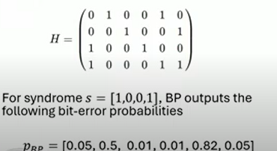
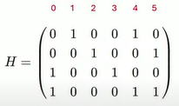
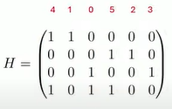

BP + OSD
BP output is used to rank bit indices from most to least likely to be in error: [4, 1, 0, 5, 2, 3]
After rearranging columns of matrix, we take the rank(H) independent columns from the left and call is H_{S}
We then invert H_{S} to calculate the e corresponding to the indices, in this case [4, 1, 0, 5] and we assume the remaining values of e is 0
Notes:
Given a syndrome, the belief propagation outputs bit-error probabilities associated with each bit.
We can then rank the belief propagation output by its indices so this example will result in a 4,1, 0, 5, 2, 3 ranking where the indices 4 correspondings to the bit with the highest probability of error
We then rearrange the columns of H according to the ranking, such that the first column now represents the bit with the highest probability. You can see the example where we swap the columns of H
So after we’ve rearrange the columns, we can take the first 4 independent columns and call it Hs so that it has full rank.
and now that we have a good full rank submatrix of H, we can take its inverse and solve for the error associated with the indices which is 4, 1, 0, 5 is the example. And for the indices that are not in Hs, we assume that their corresponding error is 0

Slide 26
References
CSS Codes: https://www.youtube.com/watch?v=izM4WEQndhQ
BP + OSD: https://www.youtube.com/watch?v=b9N2Ps3FTto
Trapping Sets: https://arxiv.org/pdf/2012.15297
BP Algorithm: https://www.youtube.com/watch?v=2pkbwZZA864

